Slide 1
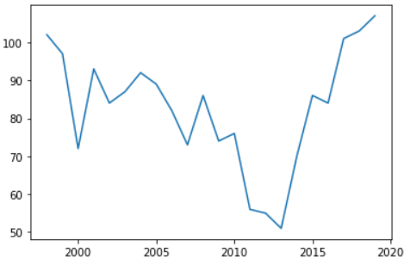

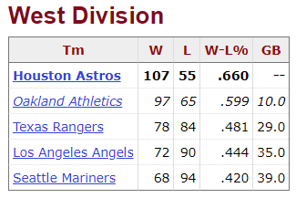


MLB Team Wins Predictor
AJ Block
Background
The Reason I chose to do this project is because I am a Mariners fan, and if you know anything bout baseball then you know that they have not been a good team for a very long time. They usually start off the season very well, but they end up falling short of the playoffs year after year and it is quite painful to watch. So, I wanted to see if I could create an algorithm that could predict how many wins any team would have. In general, a team usually needs to win around 96 / 162 games to make playoffs.
Methods
The main idea of this dataset is to define the weights of the data. I obviously the prediction of how well a team does in the 2021 season to be more influenced by their season wins/loss record in 2019 compared to 1998. Currently, I am working to classify the data as a time series where the more recent values will have a higher weight than the older values. I am trying to use a rolling mean on the dataset, however I think the weights are still a bit off for now.
Results
The results of the predictions for the number of wins each team will get are promising for now, however I am still not doing something correct. One idea I had was that the data is so inconsistent with some teams having good and bad years that it is very tough for my model to correctly predict this. The other idea that I am still working on is the weighting of each season may be off still. The most recent seasons may need to be weighted far heavier than any other season, but that would almost throw out the idea of using more than 4 or 5 past seasons as predictors
Data
I collected data from all 30 current MLB teams of their total wins for each season. I gathered data from the 1998 – 2019 seasons. There were a few strikes from players and teams, as well as new teams being added around 1994 and 1995 so I figured that a couple years after all of that happening would be a good place to start.
Conclusion / Future Work
Once I am happy with the weights and results of this study, I want to add an output of each team. I want to have a list that represents each team’s projected record, as well as their projected standings compared to the rest of the MLB, and within each of their respected leagues.

